Slide 1


Intoduction To Computer Science
SAMEER KHAN
Sameer Khan
Practical work

Slide 2
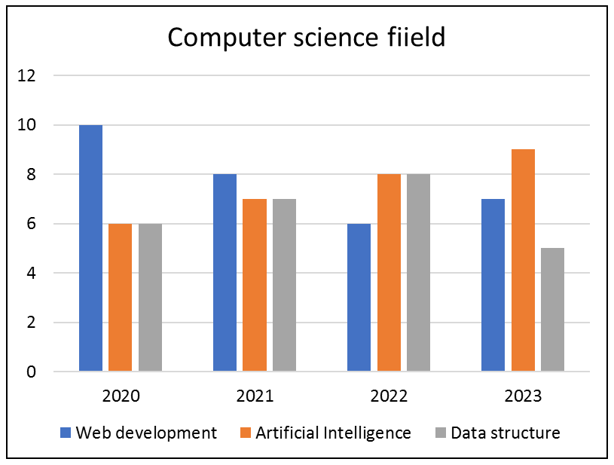
What is Computer Science?
Definition:
Computer Science is the study of computers and computational systems, encompassing theory, development, and application.
Key Areas:
Algorithms: Steps to solve problems.
Data Structures: Organizing data efficiently.
Programming: Writing instructions for computers.
Software Development: Creating software applications.
Sameer Khan
Practical work

Slide 3

Core Concepts
Programming Languages:
Examples: Python, Java, C++, JavaScript.
Importance: Foundation for creating software.
Algorithms and Data Structures:
Sorting, searching, and managing data efficiently.
Databases:
Storing and retrieving large amounts of data.
Sameer Khan
Practical work

Slide 4
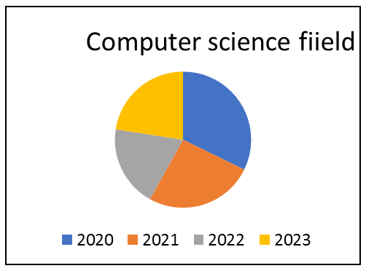
Applications of Computer Science
Software Development:
Creating applications for various platforms.
Artificial Intelligence (AI):
Machines that simulate human intelligence.
Cybersecurity:
Protecting systems and data from threats.
Web Development:
Building websites and web applications.
Sameer Khan
Practical work

Slide 5

Future Trends in Computer Science
Artificial Intelligence and Machine Learning:
Enhancing automation and decision-making.
Quantum Computing:
Revolutionizing computing with quantum mechanics.
Blockchain:
Securing data with decentralized technology.
The Internet of Things (IoT):
Connecting devices to create smarter environments.
S no | Web development | Dsa
1 | To doweb dev you need dsa | To do dsa you have not need to do web dev.2
2 | For doing wev dev, you ca use html,css,javacript,react js,node | For doing dsa , you need programming language for c,cpp,jaca,python
Sameer Khan
Practical work

